Slide 1

RUNGTA COLLEGE OF DENTAL SCIENCES & RESEARCH
TITLE OF THE TOPIC
MYCOTIC INFECTIONS
DEPARTMENT OF ORAL PATHOLOGY & MICROBIOLOGY

Slide 2
GUIDED BY:-
DR. SIDDHARTH PUNDIR
DR. SUDHANSHU DIXIT
MYCOTIC INFECTION OF ORAL CAVITY

Slide 3
Specific learning Objectives
;
Core areas* | Domain ** | Category #
INTRODUCTION | COGNITIVE | MUST KNOW
CANDIDIASIS AND ITS TYPES | COGNITIVE | MUST KNOW

Slide 4
Table of Content
INTRODUCTION
CANDIDIASIS AND ITS TYPES

Slide 5
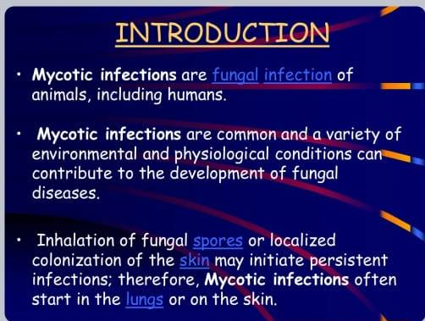

Slide 6
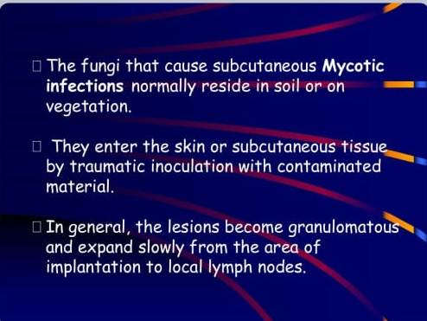

Slide 7
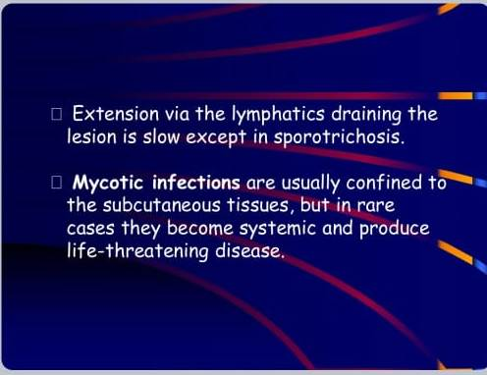

Slide 8
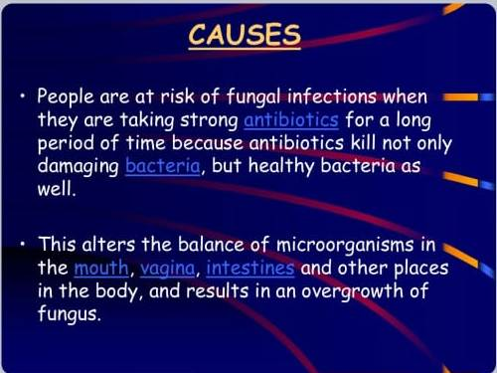

Slide 9
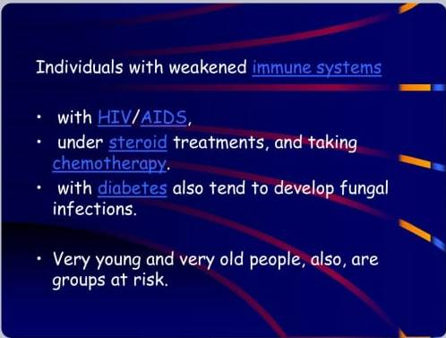

Slide 10
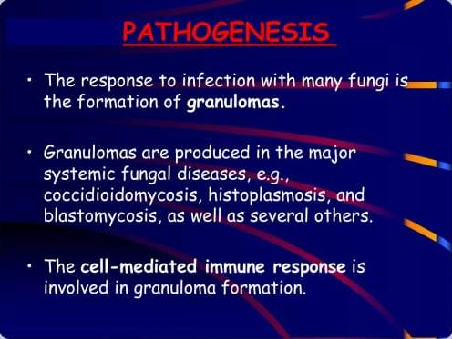

Slide 11
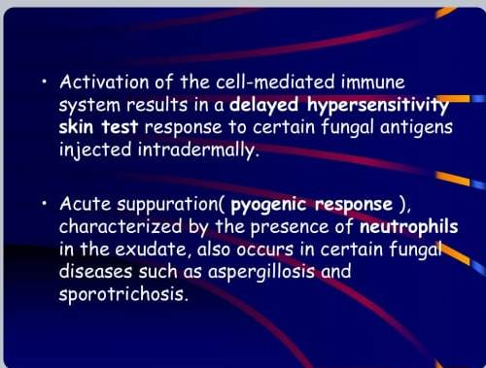

Slide 12
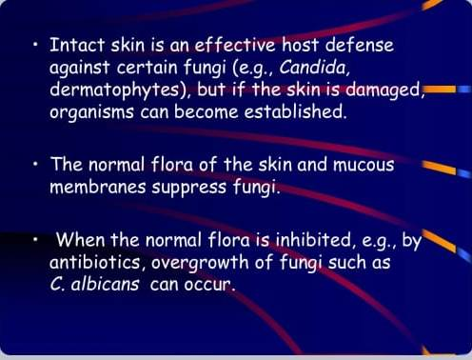

Slide 13
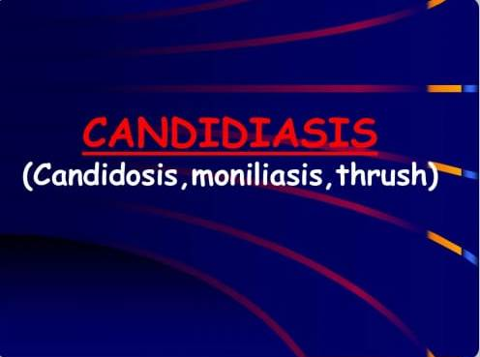

Slide 14
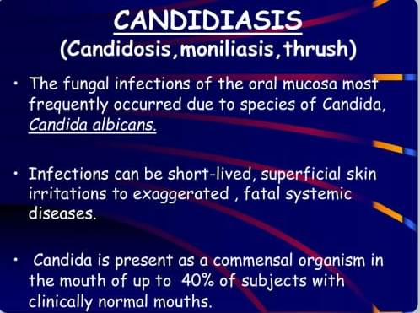

Slide 15
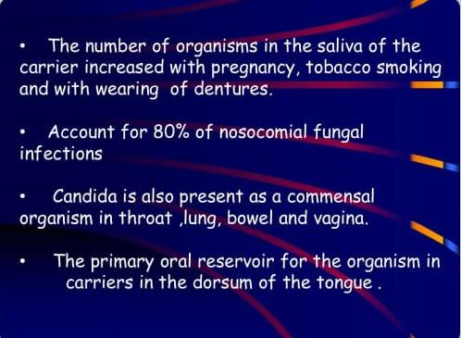

Slide 16
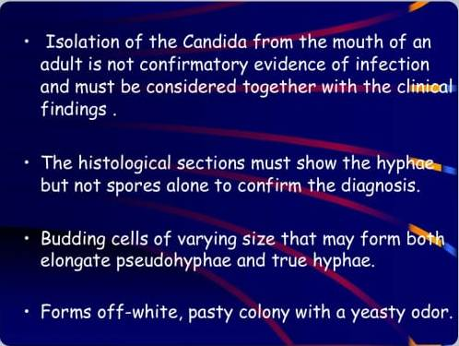

Slide 17
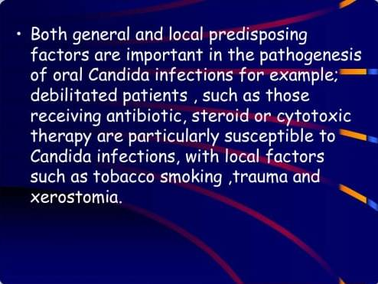

Slide 18
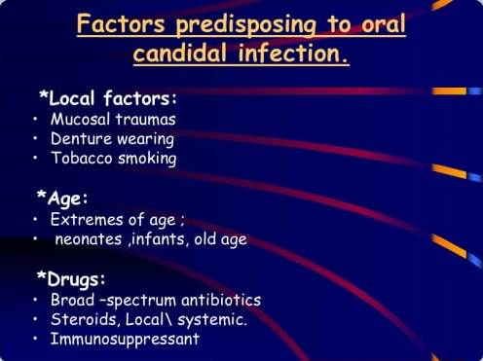

Slide 19
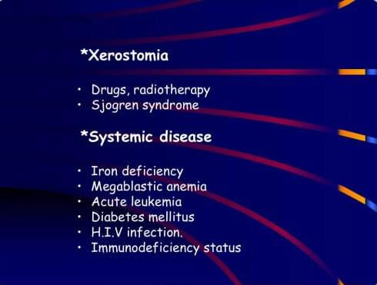

Slide 20
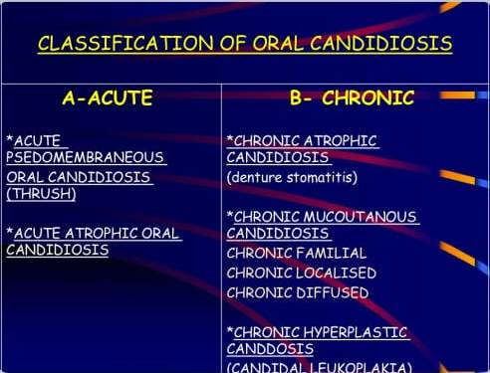

Slide 21
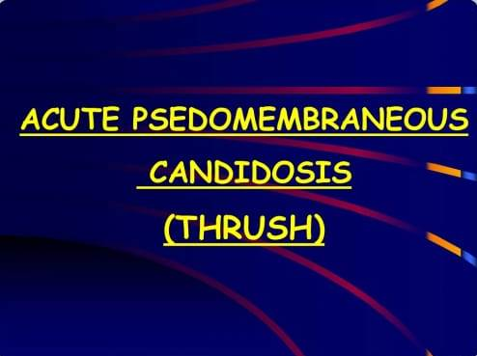

Slide 22
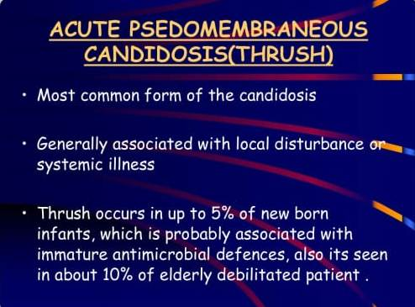

Slide 23
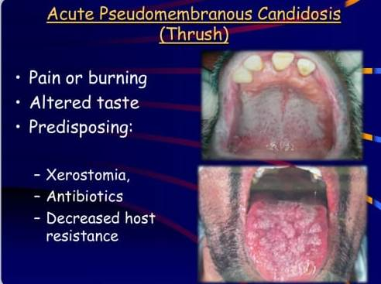

Slide 24
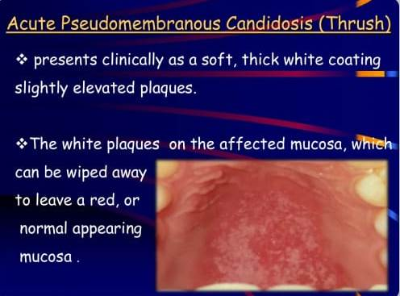

Slide 25
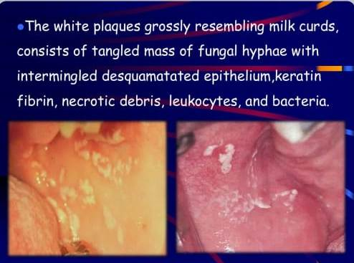

Slide 26
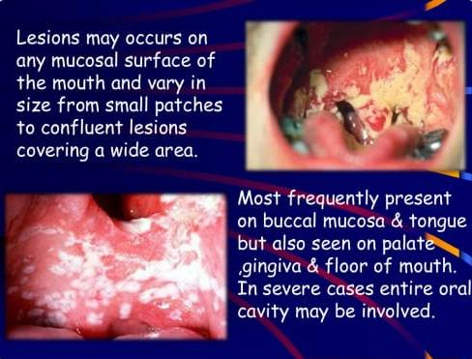

Slide 27


Slide 28
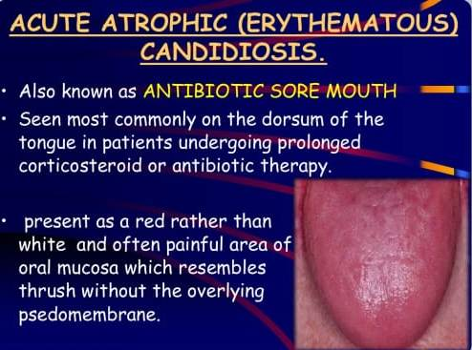

Slide 29
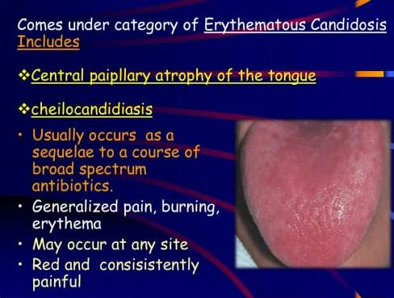

Slide 30
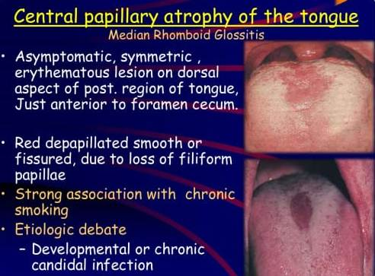

Slide 31
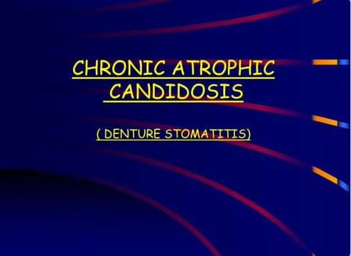

Slide 32
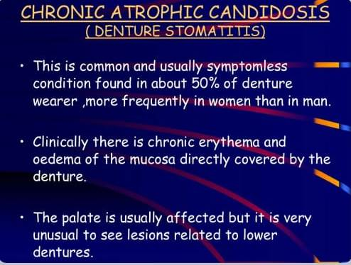

Slide 33
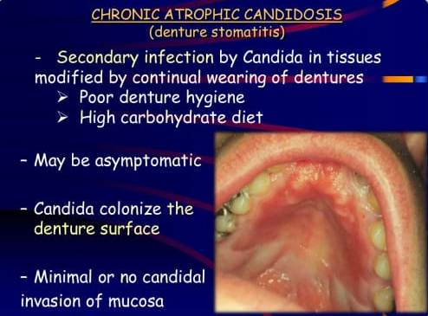

Slide 34
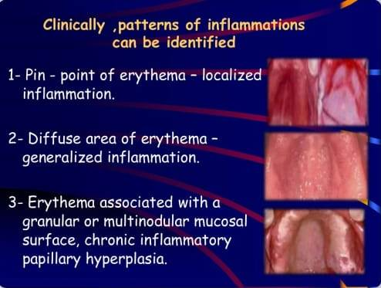

Slide 35
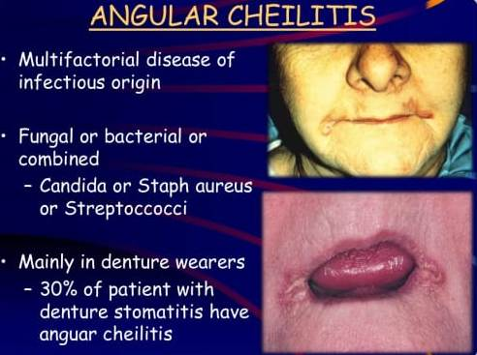

Slide 36
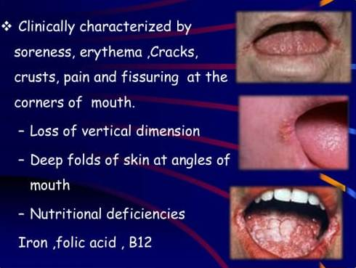

Slide 37


Slide 38
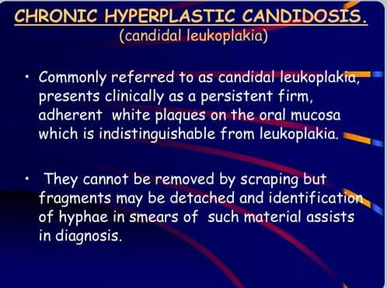

Slide 39
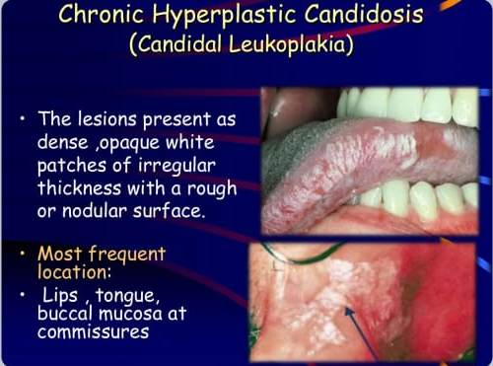

Slide 40
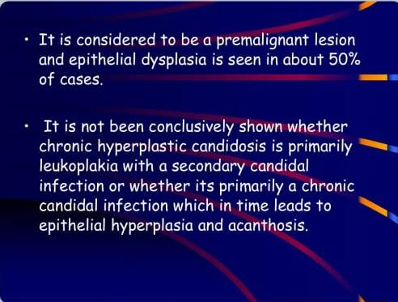

Slide 41
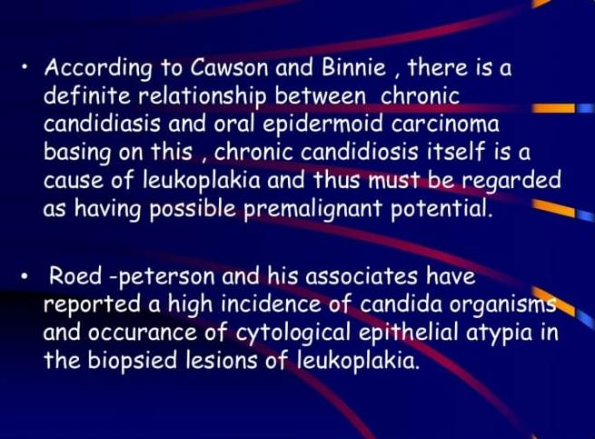

Slide 42
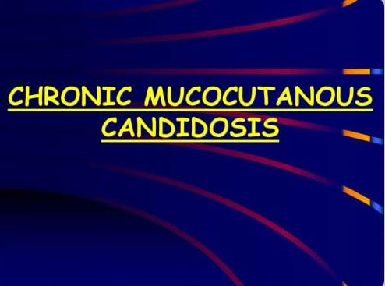

Slide 43
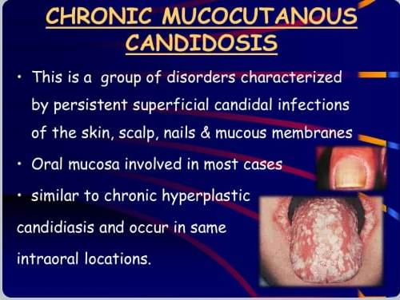

Slide 44
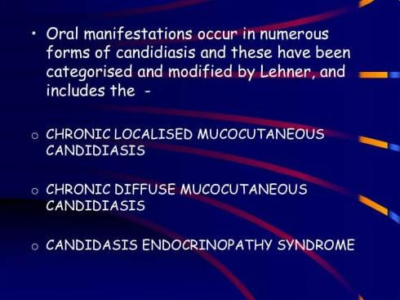

Slide 45
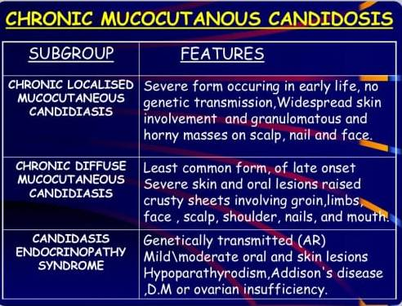

Slide 46
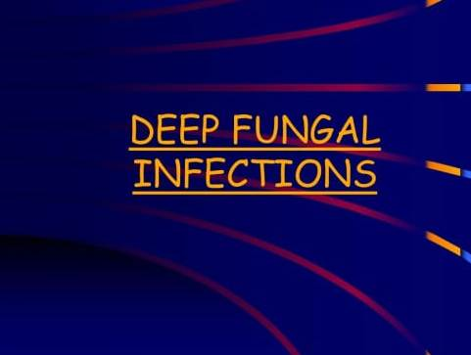

Slide 47
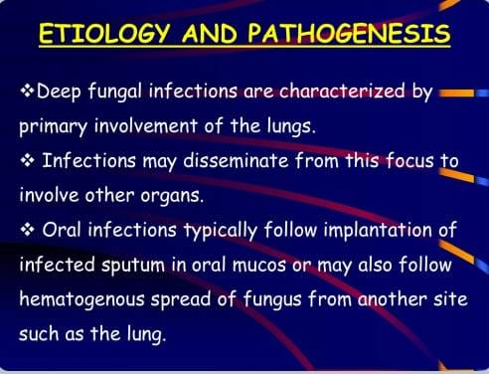

Slide 48
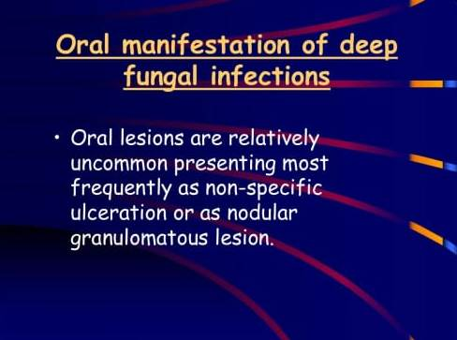

Slide 49
Take home message
The most common fungal infection of the oral cavity is candidiasis
The existence of candida can be a part of normal commensal
The pathogenicity of candida is witnessed as opportunistic when immune status is compromised

Slide 50
Question & Answer Session
FACTORS PREDISPOSING TO CANDIDAL INFECTIONS.
DENTURE STOMATITIS
ANGULAR CHEILITIS
CANDIDAL LEUKOPLAKIA

Slide 51
REFERENCES
NAME OF THE BOOK WITH EDITION AND PAGE NUMBERS
ARTICLE ARE TO BE MENTIONED IF NEEDED
SHAFER’S 9th EDITION
LUCAS
NEVILLE
REGEZI

Slide 52
THANK YOU

